Slide 1
BURGER RINGS
GROUP 6 – Brandon Rothstein, Kassidy Burrows, Leo Zhao, Jack Huang, Parker Hoyt
February 23rd, 2023

Slide 2
Mission Statement
“We aim to bring the classic American tradition of a burger, to the convenience that comes from a bag of chips.”
Notes:
Brandon

Slide 3
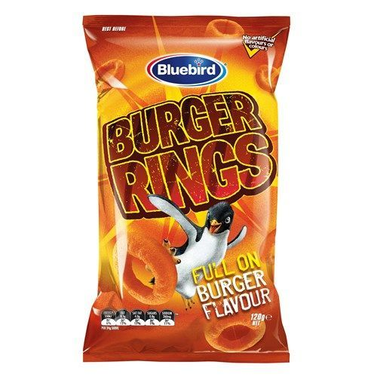
PRODUCT BRIEF
Burger Rings
Sizes
Corn based
Vegan friendly
Crispy with unique burger taste
Three Size Options:
70 grams
120 grams
220 grams (party size)
Flavor
Staple burger flavor – mixture of tomato, cheese and BBQ
Only chip brand/company to provide the one-of-a-kind flavor
Notes:
Kassidy
Mention that the product is from Australia
”Corn based, vegan friendly, crispy chips from Australia”

Slide 4
SITUATION ANALYSIS
Secondary and Primary Market Research

Slide 5
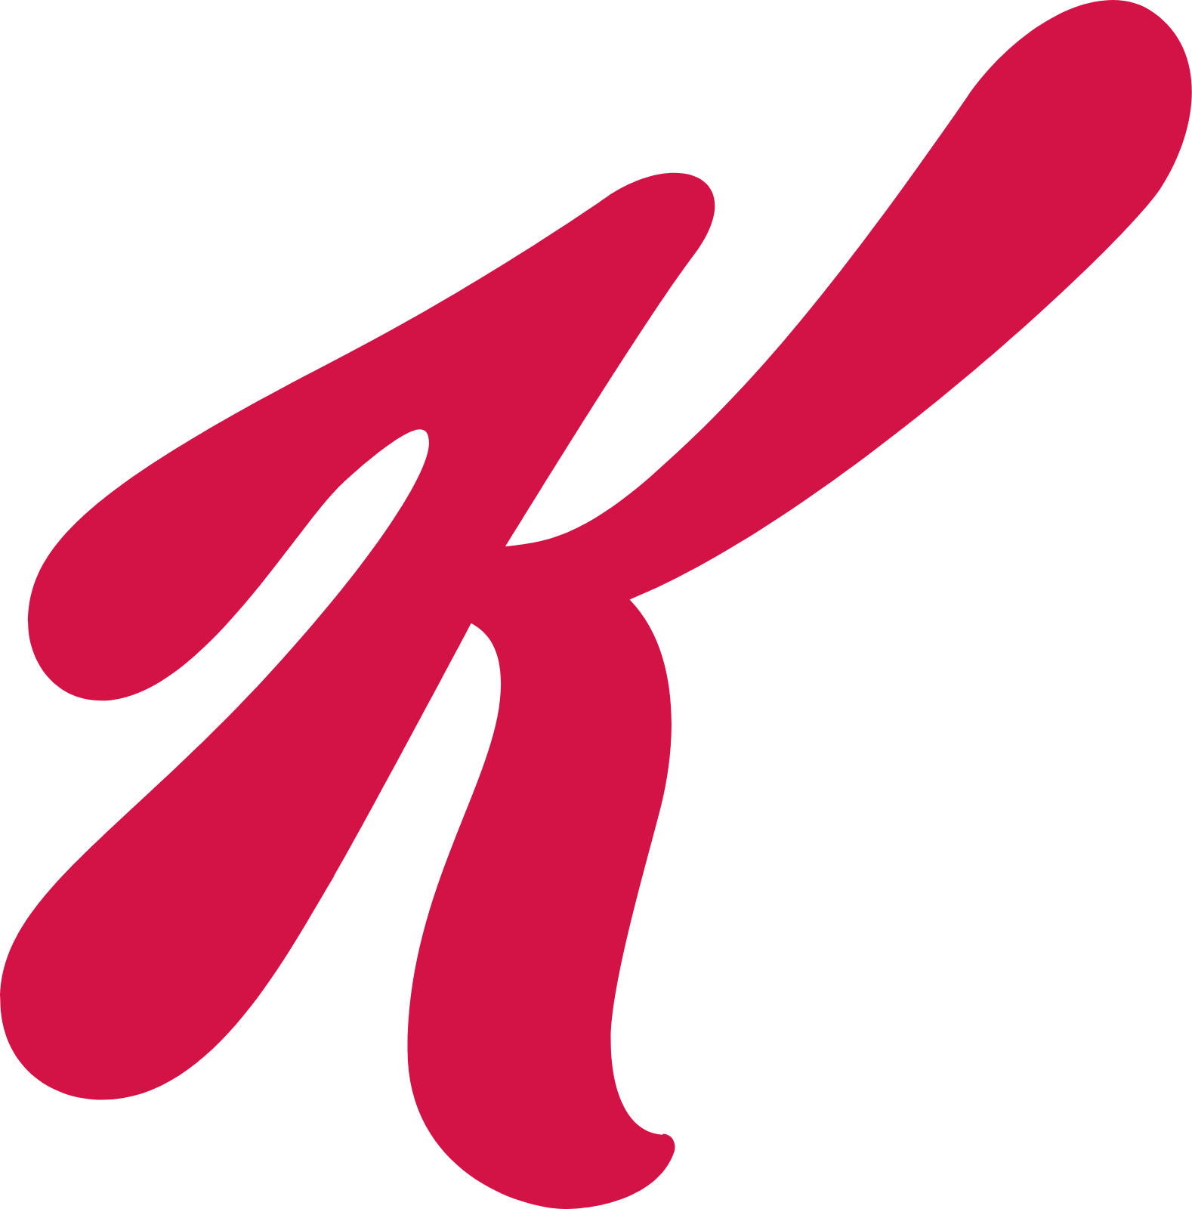
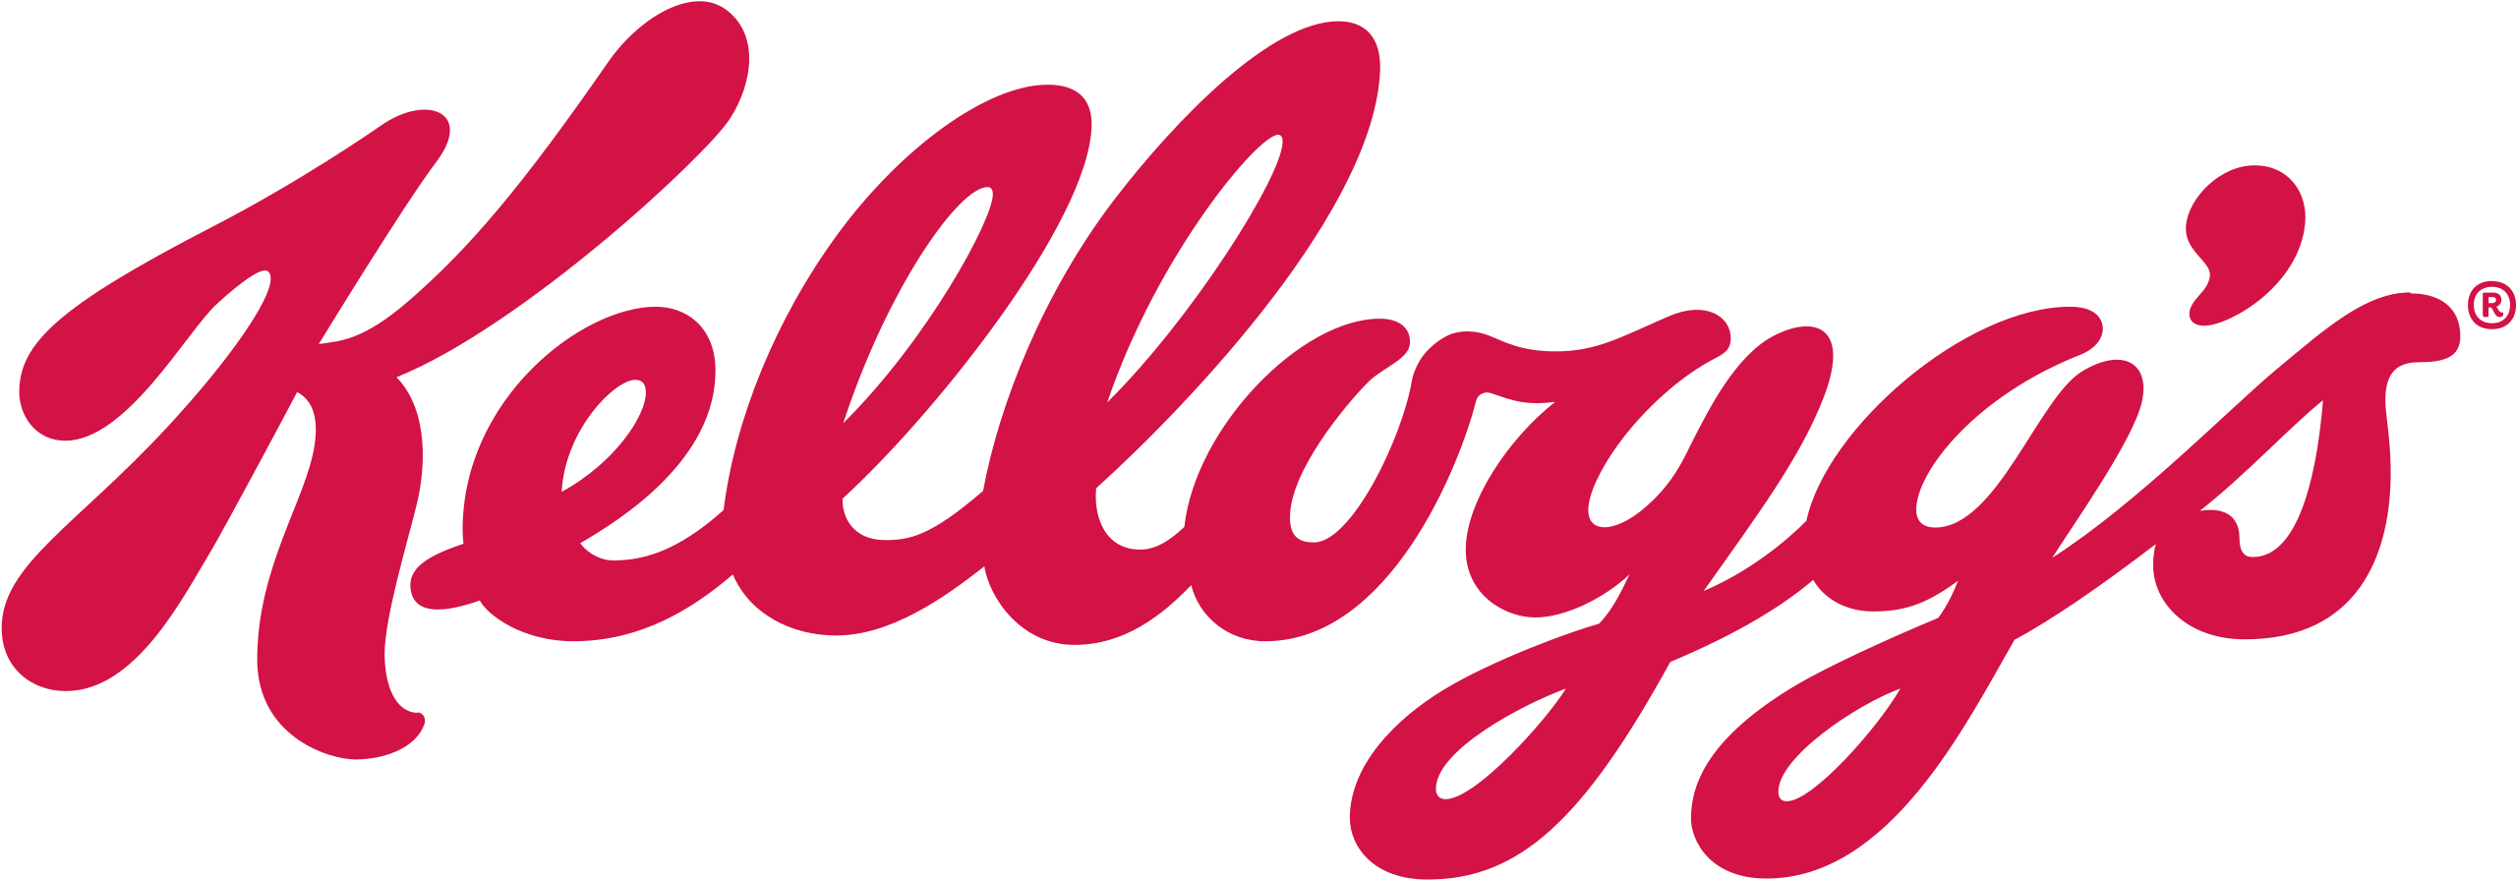
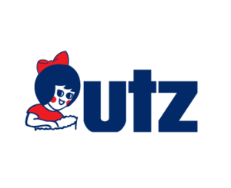
CHIP INDUSTRY MARKET SHARE
Current market share of top established chip companies
63% Pepsi Co.
Kellogg’s 7.5%
6% Utz
Private Label 6%
Mintel reports: Consumer Market Analysis. Mintel.com. (n.d.). Retrieved from http://www.reports.mintel.com/
Notes:
Parker

Slide 6
2022 CHIP COMPANY SALES
Current Sales of the top established chip companies
$8.45 B Pepsi Co.
Kellogg’s $1.01B
$810M Utz
Private Label $807M
Mintel reports: Consumer Market Analysis. Mintel.com. (n.d.). Retrieved from http://www.reports.mintel.com/
Notes:
Parker

Slide 7
FUNYUN CONSUMPTION
How many bags of Funyuns chips have you eaten in the last 30 days?
Published by Statista Research Department, & 23, J. (2022, June 23). U.S.: Bags of funyuns corn / tortilla chips eaten in the U.S. 2020. Statista. Retrieved February 23, 2023, from https://www.statista.com/statistics/288740/bags-of-funyuns-corn-tortilla-chips-eaten-in-the-us/
Notes:
Parker

Slide 8
PRIMARY RESEARCH
From a google form survey we sent out to college students around the country. It resulted in 91 responses.
75%
35%
70%
Of respondents, said they would be interested in trying Burger Rings
Of respondents said, they usually buy small single serve bags of chips
Of respondents said, they like the texture of Funyuns.
A very similar texture to Burger Rings
Notes:
Brandon
Dates: “We conducted a survey from Feb. 21-28
We got 91 responses from college students mainly between the ages of 17 and 25
Most of them were from NY but we got a wide range with getting answers from people native to Kentucky, California, North Dakota and even India and Puerto Rico

Slide 9
FLAVOR PREFERENCES
Which of the following flavors sound the most appealing?
Notes:
Brandon
After the two primary research slides mention something about how this shows there is interest in the burger rings and seeing the product expand which is an opportunity we should capitalize on after our launch

Slide 10
SWOT ANALYSIS
Strengths
Weaknesses
Unique product
Produced by Pepsi Co. (already established brand with wide distribution)
Vegan Friendly
Flavor can be off-putting at first glance
Limited flavor options
Opportunities
Threats
Can enter American markets
Expanded product line – create new flavors of burger rings (ie. Bacon, Cheeseburger, Garlic Aioli)
Unfamiliar to Americans
Competitors (ie. Funyuns, Pringles, Utz)
Other companies have larger variety of chip flavors (ie. BBQ, Ketchup, Sour Cream and Onion)
Notes:
parker

Slide 11
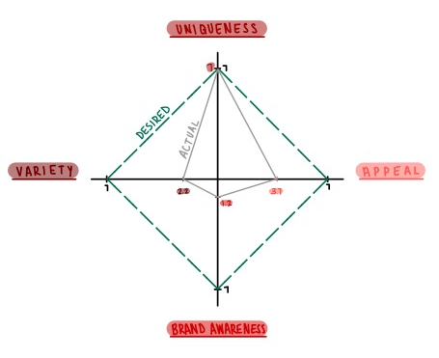
BURGER RINGS
BRAND MAP
Notes:
Jack
Uniqueness: 7
Appeal: 3.7
Brand Awareness: 1.2
Variety: 2.2

Slide 12
KEY TAKEAWAYS
Grow Brand Awareness
Improve Product
Expand availability in the United States
Target existing markets for similar chips (Funyuns, BBQ, etc)
Use existing connections and opportunities created by parent company
Offer small, single serve bag size
Launch exciting new flavors
Lower prices to compete with cheaper chip options
Notes:
Leo
Expand into US
Target the existing market for similar chips
Use connections and opportunities from parent company
Offer single serve suze
Launch new flavors
Lower prices to compete with cheaper chips

Slide 13
MARKETING DIRECTIONS
Objectives, Target Group, and Strategies

Slide 14
Burger Rings’ Objective
Our objective is to surpass Funyuns in annual sales by 15% within two years by working to build the brand awareness in America
Notes:
Jack

Slide 15
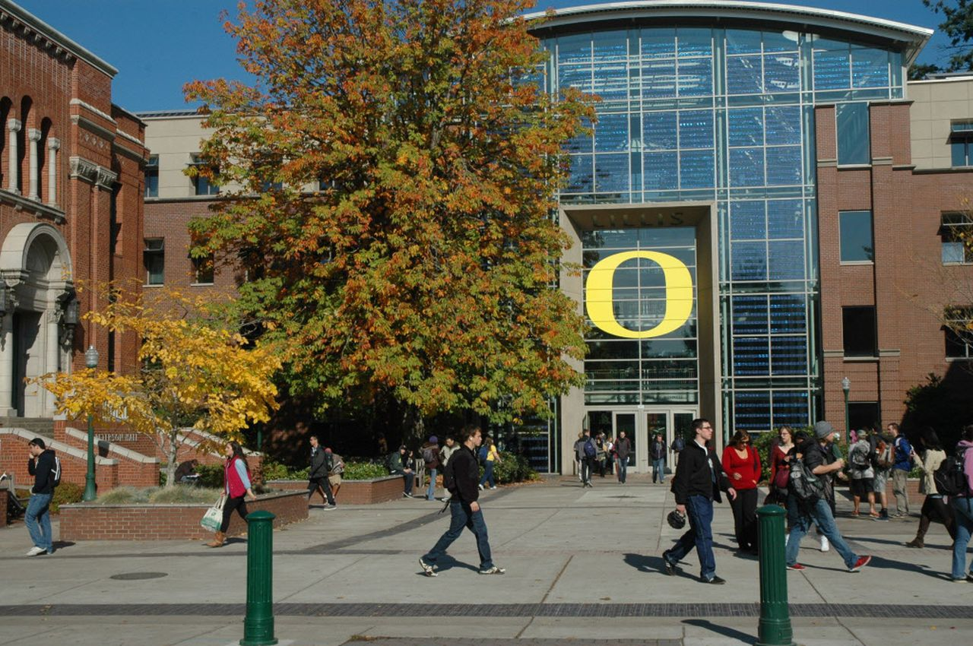
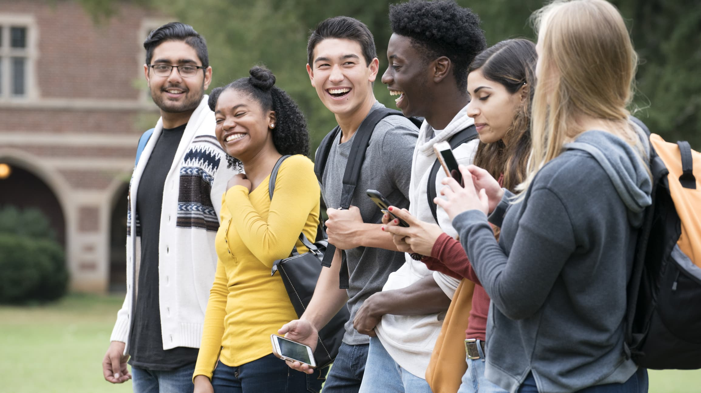
TARGET MARKET
Burger rings wants to target individuals who are between the ages of 18 and 24 located in Oregon. They are most likely single and have low to no income as they are currently enrolled in college. Additionally, they don’t have an emphasis on healthy habits because they like to snack due to their busy and hectic schedule.
Notes:
parker

Slide 16
PRODUCT PLAN
Strategies
Market Development
We are bringing an existing product, Burger Rings, to a new market, America.
We are introducing a fresh product and broadening the market
Diversification
We want to expand the product line of Burger Rings in order to diversify the American market
We plan to establish this existing product with fresh aspects in a market they have yet to be seen in
Notes:
parker

Slide 17
PRODUCT PLAN
Action Plan
Introducing Burger Rings
With Burger Rings being a foreign product to American markets – It’s unique flavor and packaging will grab consumer’s attention
Expanded Product Line
By introducing new flavors like, Garlic Aioli, Bacon, and Cheeseburger, we can create a wider product line for Burger Rings
With these flavors we would bring them to local colleges (ie. University of Oregon) for students to taste test the original and new flavors in return for their feedback
Notes:
parker

Slide 18
DISTRIBUTION
Strategies
Indirect distribution channel
Burger Rings will use distributors to reach consumers through popular retailers and wholesalers
Merchant wholesaler:
To help promote the brand in their stores
Take care of the financial aspect of reselling in the store
Notes:
kassidy

Slide 19
DISTRIBUTION
Action Plan
Location
Eugene, Oregon- Oregon has the highest Funyuns and Burger consumption and the University of Oregon’s home is Eugene
Walmart, Costco and Target at the chip aisle end caps
Just In Time (JIT)
Since Burger Rings are a new product, we do not want to have excess product if it does not sell
When Burger Rings become popular it will increase demand allowing for more inventory to be sold
Notes:
Kassidy
Just a suggestion: when you discuss the funyun and burger consumption make sure to say at some point “research shows” just so people know we aren’t just whipping that up! - Parker

Slide 20
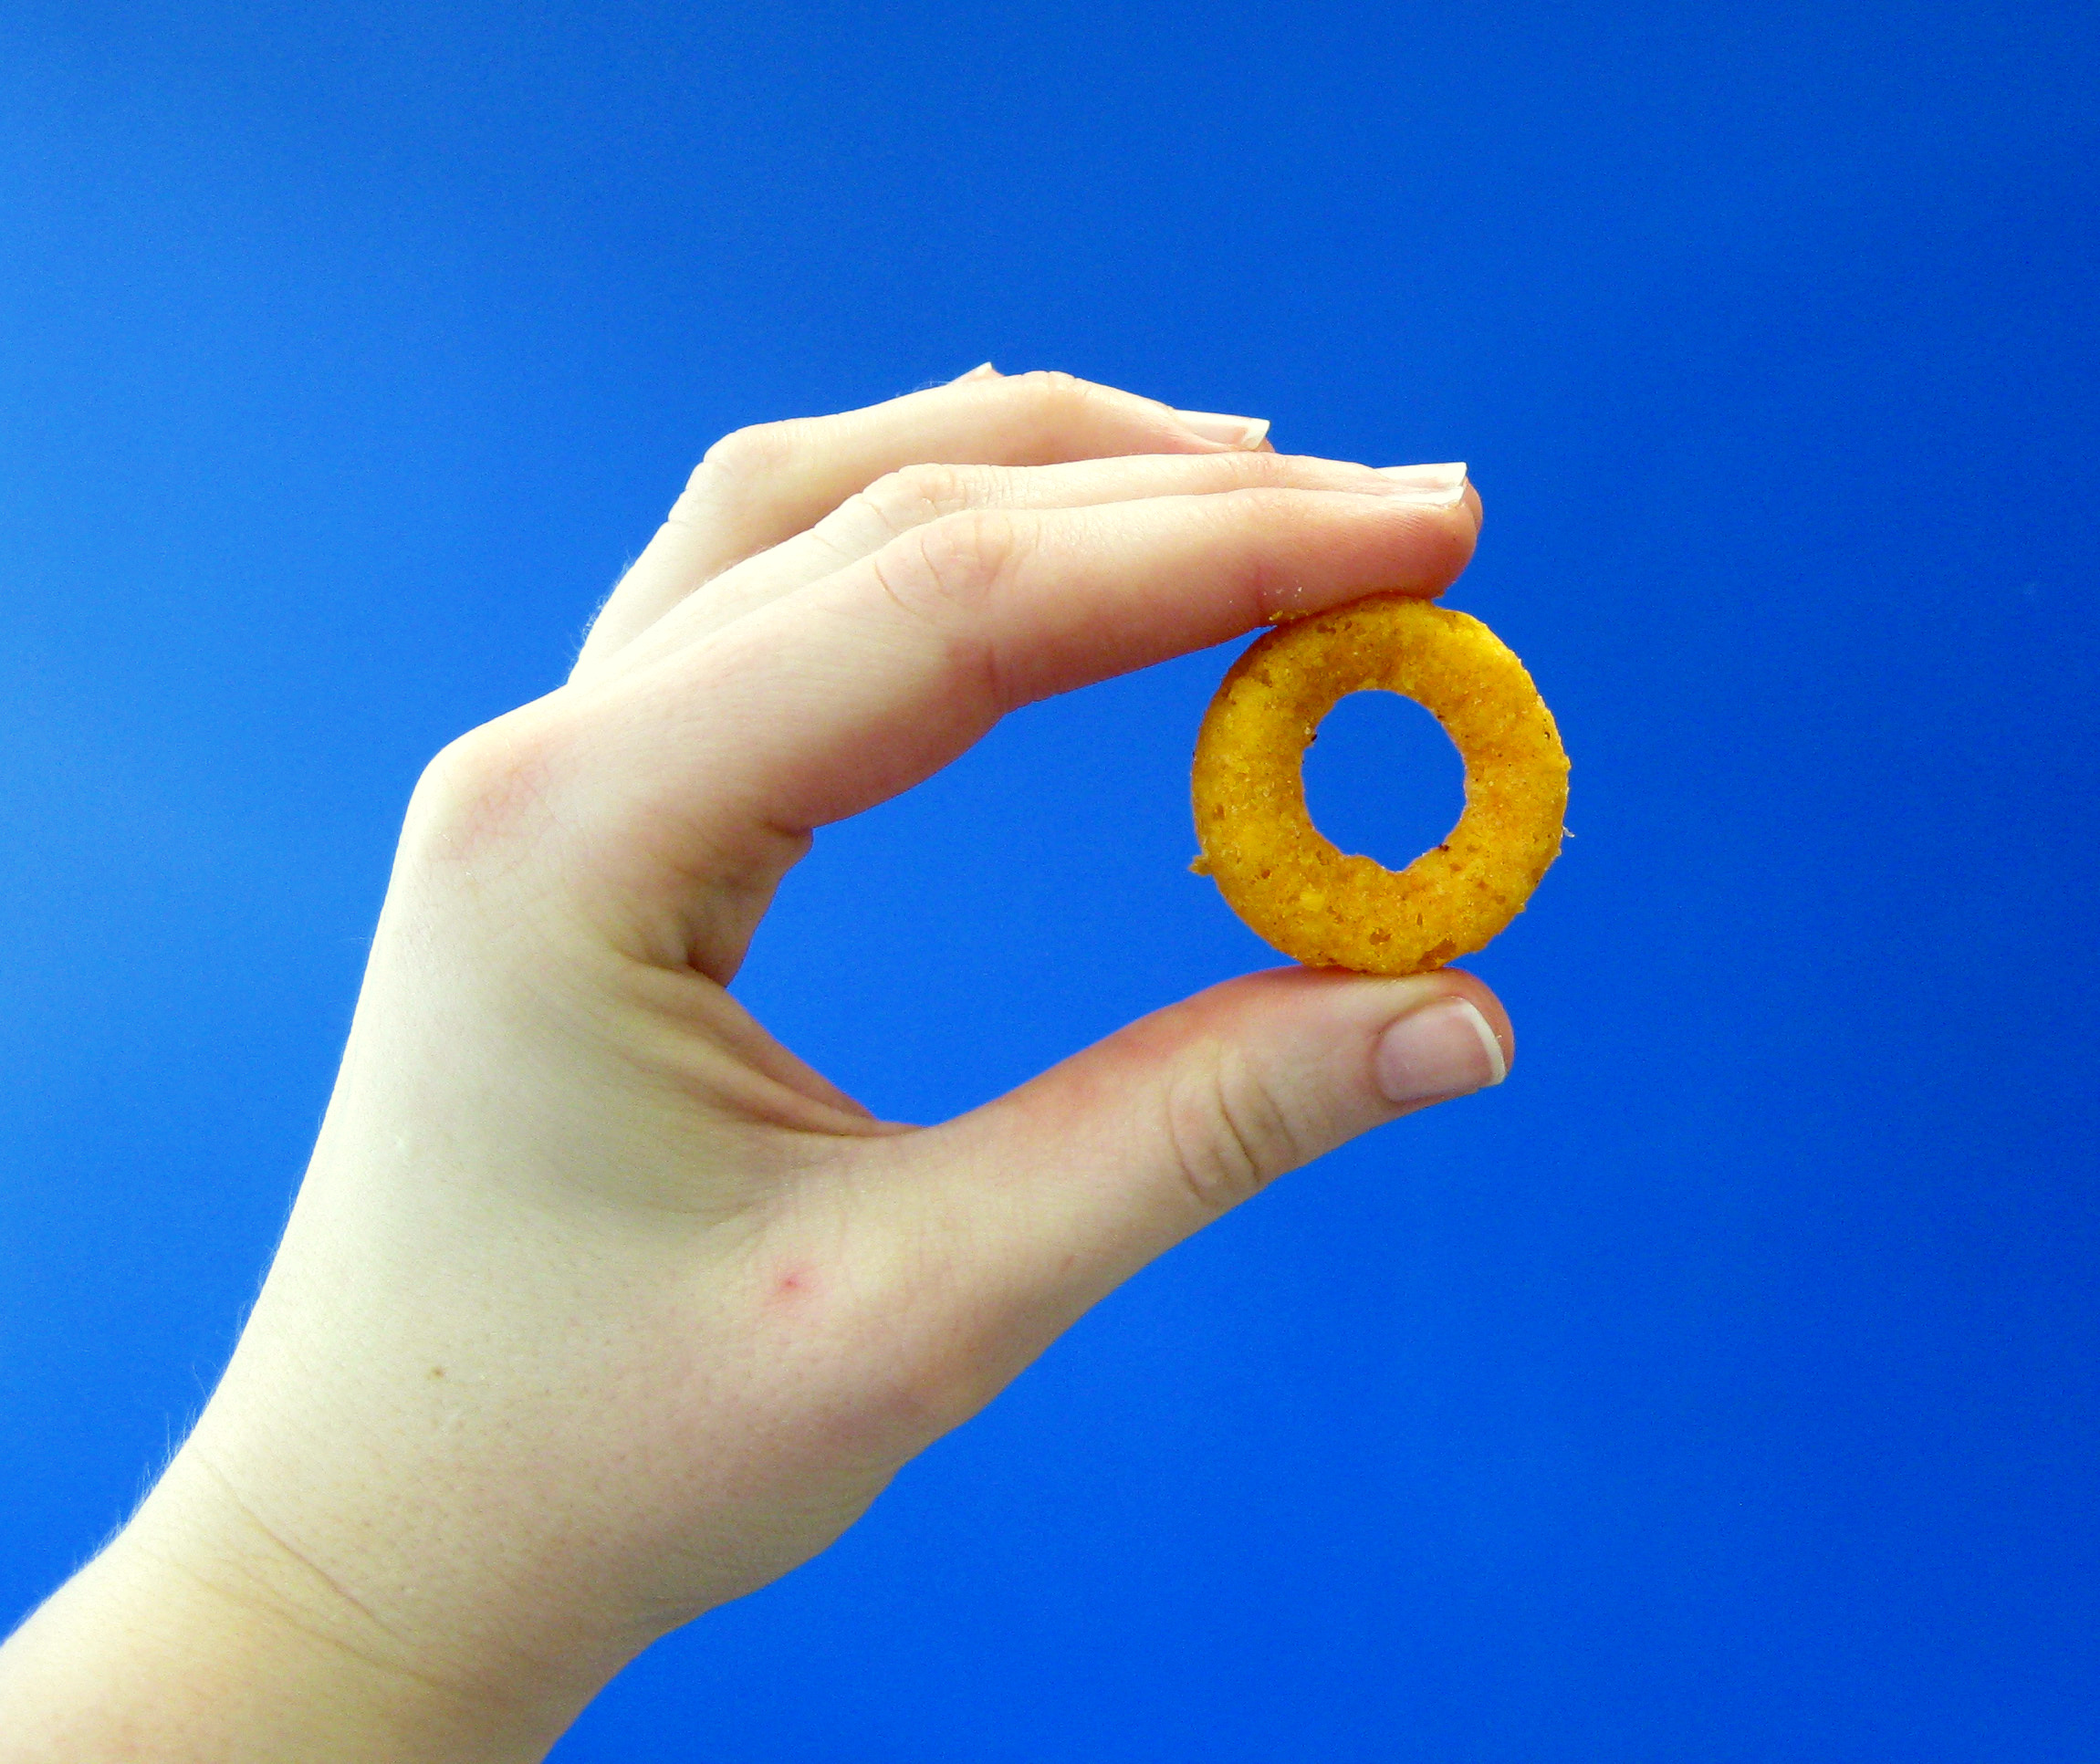
PRICING
Strategies
Penetration Price
Provide potential customers with sense of value to purchase a bag of burger rings
Allows for a fair price point (where we don’t oversell and are not able to turn a profit because product is not “worth the price”)
Cost based Pricing
Cost‐based pricing sets prices based on the costs for producing, distributing, and selling the product plus a fair rate of return (profit)
We want to keep Burger Rings at a reasonable price that ensures us a revenue to cover expenses and hopefully turn a profit
Notes:
leo
Use two strategies
Penetration price
to provide pontential consumers a sense of value to purchasing a bag of burger rings
Fair price point – consumers don’t feel like they are overspending/underspending
Cost based pricing – sets prices based on overall costs to make burger rings and be able to turn a profit

Slide 21
PRICING
Action Plan
Product costs (30 cents per bag)
All the ingredients and flavoring are unique to Burger Rings and are made in house
Some ingredients include Corn, Rice, Onion Powder and Tomato Powder
Distribution Process ($13.7 billion per year)
Made & Packaged
Sent to distribution center
Sold to consumer through different channels (grocery store/e-commerce/wholesale)
Notes:
leo
Flavoring is made in house
Highlight corn rice onion powder and tomato powder

Slide 22
PRICING
Action Plan Con’t.
Advertisement ($100 million per year)
Channels of communication - Packaging (material/graphics/etc.), social media, and TV ads
Price
Using the mentioned strategies and keeping our costs in consideration, the price per bag would be: $3 - $6 (depending on size of the bag)
Notes:
Leo
Advertising –
social media (tiktok and Instagram)
TV ads (Superbowl)
Bring us to price at around $3-6 dollars for bag depending on sizw

Slide 23
PROMOTION PLAN
Strategies
Create a Brand Personality
Design digital and physical advertisements for Burger Rings
Use consistent slogans and colors in advertisements to become memorable
Engage Target Market
Use online advertisements to reach the target consumers (using ads and social media accounts)
Advertise in similar channels to competitors to capture consumer interest in Burger Rings
Notes:
brandon

Slide 24
PROMOTION PLAN
Action Plan
Develop Digital and Physical Advertisements
Create video advertisements for television and streaming services
Create static advertisements for physical display (billboards and in stores) as well as digital advertising on social media
Create Brand Social Media Accounts
Create official social media accounts for Burger Rings across various popular platforms (Instagram, Twitter, Tiktok)
Interact with the community to reach both potential customers and previous customers to build an accessible brand that can be reached by consumers
Notes:
brandon

Slide 25
Burger Rings’ Slogan
“Ringing in the flavor” We wanted to express the feature that makes us different by emphasizing the flavor of Burger Rings while playing off the word “ring”
Notes:
brandon

Slide 26
SCHEDULE & COST
Timeline and Cost Estimate

Slide 27
SCHEDULE
Year | 2024 |  |  |  |  |  |  |  |  |  |  |  | 2025
Month | 1 | 2 | 3 | 4 | 5 | 6 | 7 | 8 | 9 | 10 | 11 | 12 | 1 | 2 | 3 | 4 | 5 | 6 | 7 | 8 | 9 | 10 | 11 | 12
Production | Test Product |  |  |  |  |  | Research Market, Gain Feedback |  |  |  |  |  | Test Production |  |  |  | Production
Distribution |  |  |  |  |  |  |  |  |  |  |  |  | Eugene, OR (Uni. Of Oregon) |  |  |  |  |  | Northwest & Western US |  |  | Nationwide
Communications |  |  |  | Sampling & Surveying |  |  |  |  |  |  |  | Marketing Campaign Planning |  |  |  | Establishing Social Media Presence |  |  |  |  | Produce TV and static advertisements
A fundamental schedule for Burger Rings to establish itself, gain traction, and reach our marketing objective
in the desired timeframe.
A fundamental schedule for Burger Rings to establish itself, gain traction, and reach our marketing objective
in the desired timeframe.
Notes:
parker

Slide 28
Cost Estimate
Factory Expense: $10,000
Warehouse Rent Expense: $25,000
Utilities Expense: $10,000
Equipment Costs: $20,000
Shipping and Distribution Costs: $60,000 to $200,000
Advertising Expense: $100,000,000
Notes:
jackk

Slide 29
THANK YOU! We hope you keep the American tradition alive with us at Burger Rings
Contact: Parker Hoyt – parkerhoyt03@gmail.com

Slide 30
References
Duff, O. (2022, August 26). This is the #1 state by Burger Consumption, new data shows. Eat This Not That. Retrieved March 23, 2023, from https://www.eatthis.com/news-top-state-burger-consumption/
Love, M. (2023, February 2). This map shows the most popular chips and dip in every state. Taste of Home. Retrieved March 23, 2023, from https://www.tasteofhome.com/article/most-popular-chips-and-dip/
Mintel reports: Consumer Market Analysis. Mintel.com. (n.d.). Retrieved March 23, 2023, from http://www.reports.mintel.com/
Published by Statista Research Department, & 11, J. (2023, January 11). Leading Potato Chip Brands (ruffles potato chips) sales U.S., 2022. Statista. Retrieved March 23, 2023, from https://www.statista.com/statistics/188222/top-potato-chip-brands-in-the-united-states/#:~:text=Lay%27s%20was%20the%20leading%20potato,potato%20chip%20market%20that%20year
Published by Statista Research Department, & 23, J. (2022, June 23). U.S.: Bags of funyuns corn / tortilla chips eaten in the U.S. 2020. Statista. Retrieved March 23, 2023, from https://www.statista.com/statistics/288740/bags-of-funyuns-corn-tortilla-chips-eaten-in-the-us/

