Slide 1
PERSONAL ELECTRONIC INDUSTRY
Hannah Benedict, Parker Hoyt, Chaemin Lim, Jacob Lau, Meshal Alhuwaidi

Slide 2
TRIVIA
Brazil
Chile
Argentina

Slide 3
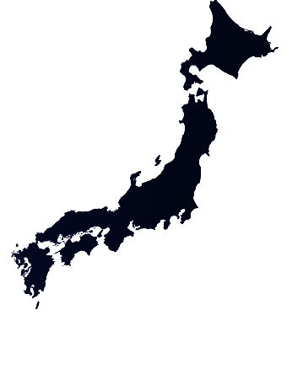
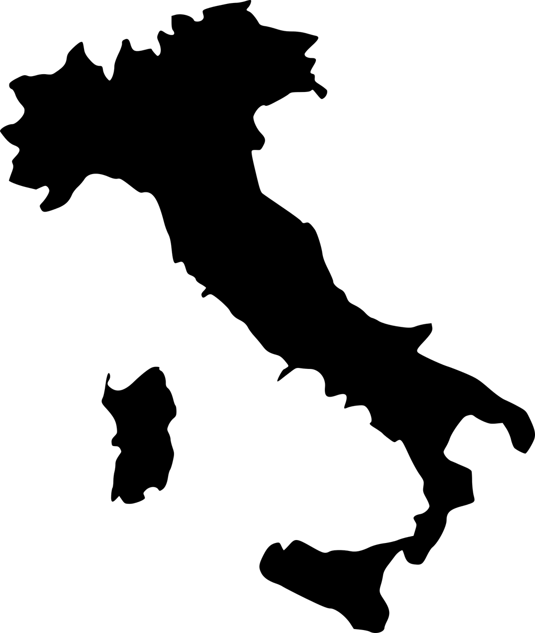
TRIVIA

Slide 4
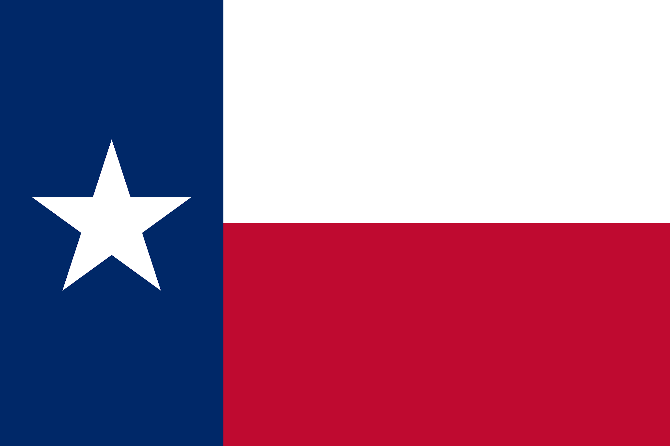
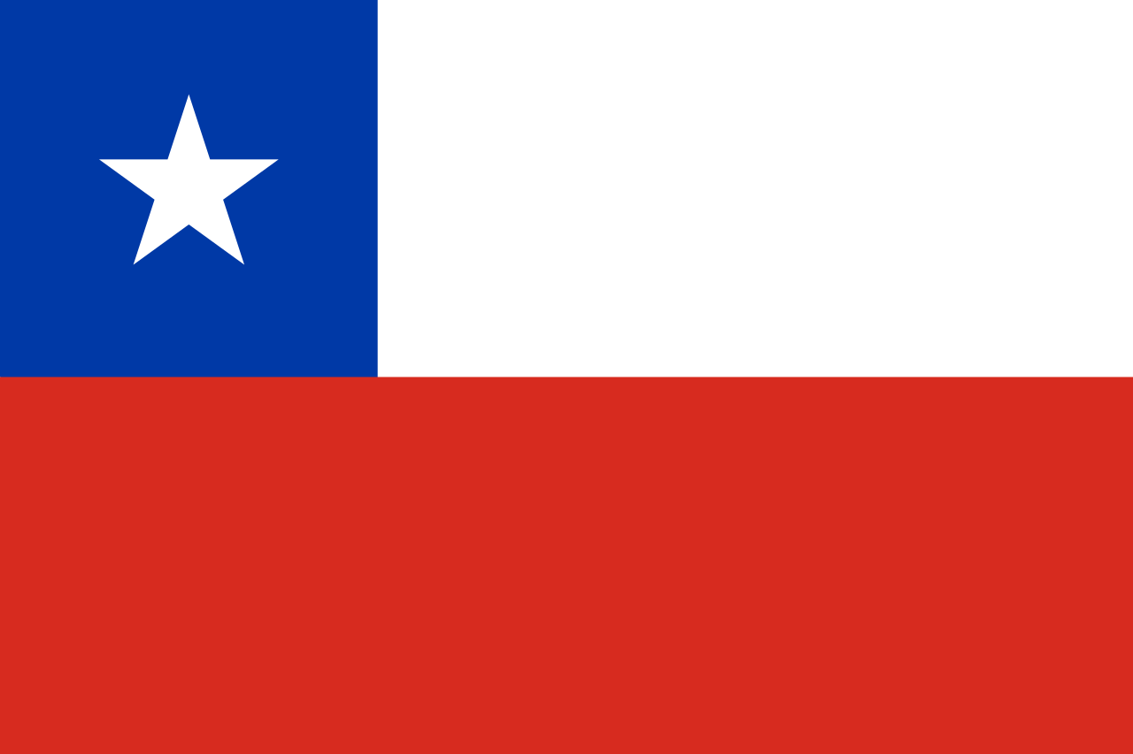
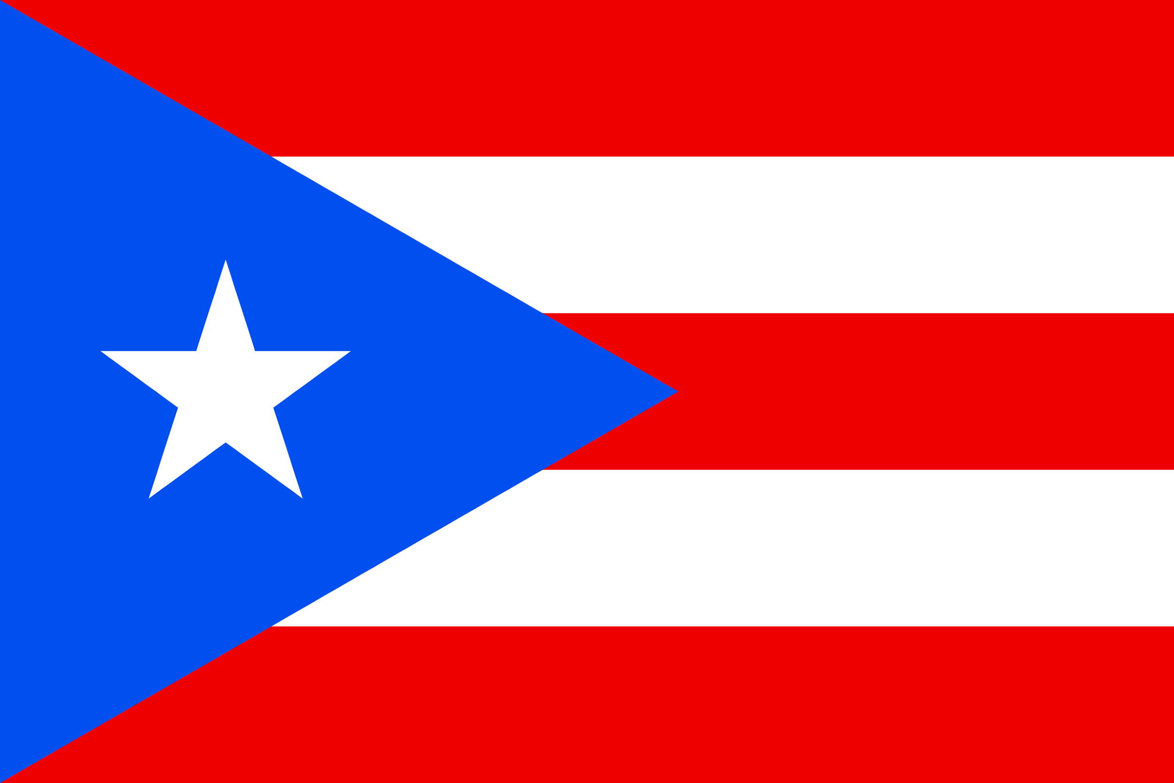
TRIVIA

Slide 5
TRIVIA
6.32 Million
19.12 Million
12 Million

Slide 6
TRIVIA
Lionel Messi
Snooki
Shakira

Slide 7
Company Information
Hannah Benedict

Slide 8
Nokia Business Model
In Finland
Nokia’s current operations are divided into two categories
Consumer-Direct
Cellphones, Computers, Smart Home Devices
Wide range in price point
Business-Direct
IP Infrastructure and networks
Security Solutions

Slide 9
Nokia’s Appeal to Consumers
Wide Target Range
Ages 18-50
$50-$550
Variety: Feature Phones (Functionality) and Smartphones (Innovation)
Heavily Advertised
3-Day Battery Capacity
Durability
Display and Camera

Slide 10
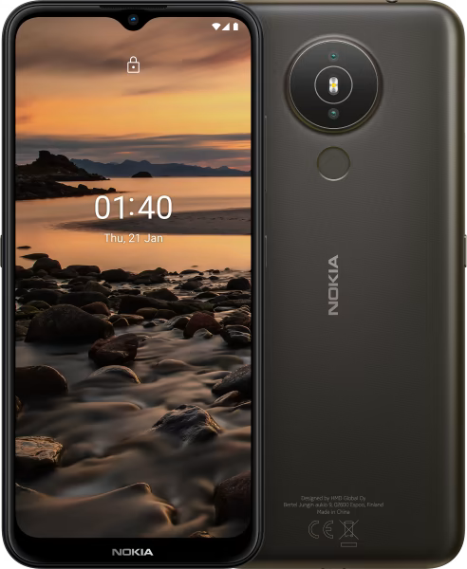
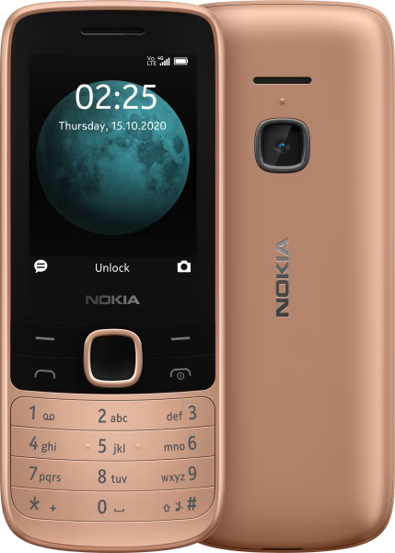
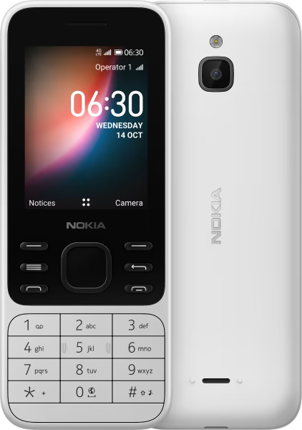
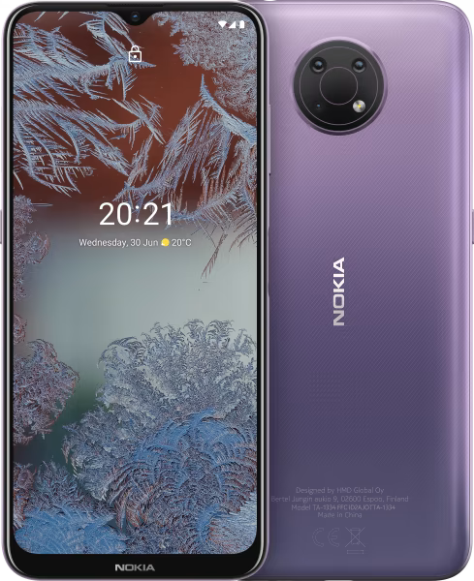
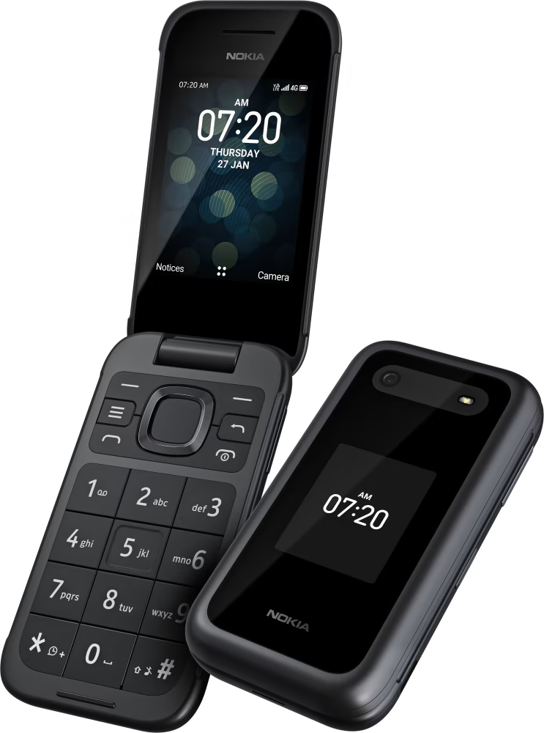
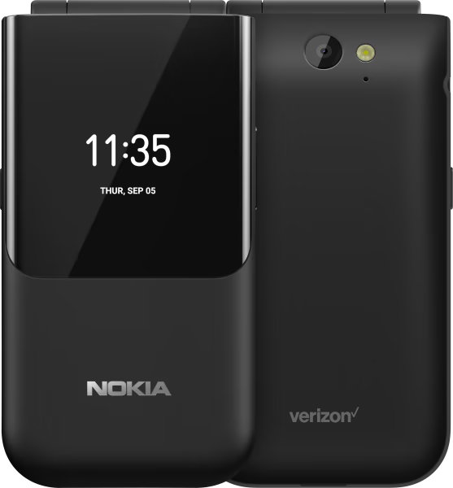
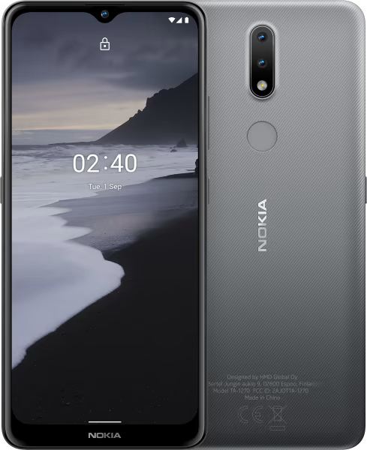
Current Product Examples
Feature Phones
Smart Phones
Under $100, focused on functionality
Up to $550, with all the bells and whistles

Slide 11
Marketing Strategy
Pricing
Penetrating for feature phones
Skimming for smartphones
Advertising
Heavily Diversified
ex. Billboards, Newspaper, TV, Radio, Display Stands, etc.
Reach entire market
Consumer Routes
Service providers
Nokia’s Website
Other online and in-store retailers
Nokia Concept Stores

Slide 12
Economic and Financial Factors
Meshal Alhuwaidi

Slide 13
Financial Factor: Currency
The currency of Chile is Chilean peso ($)
The coins of Chilean pesos are; 1, 5, 10, 50, 100, and 500
Bank-notes are; 500, 1000, 2000, 5000, 10000, and 20000 Chilean pesos

Slide 14
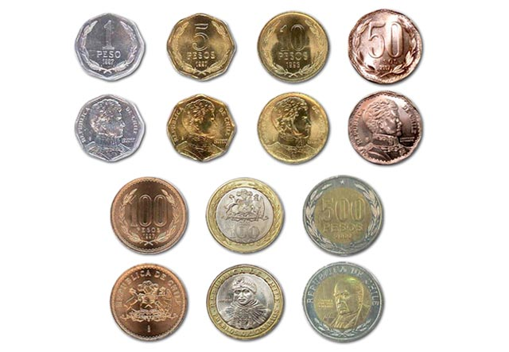

Slide 15
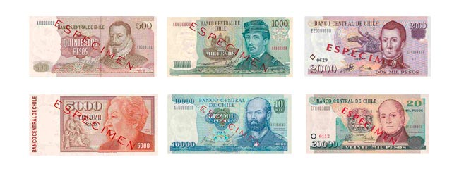

Slide 16
Financial Factor: Taxes
The individual income tax is charged at prograssive up to 40%
Companies income tax is imposed at a rate of 17%
Standard rate of VAT (value added taxes) is 19%

Slide 17
Financial Factor: Interest Rate
Chile’s Central bank enacted its largest interest rate hike in 20 years, increasing the basis rate by a lager than expected 150 basis points to 5.5%

Slide 18
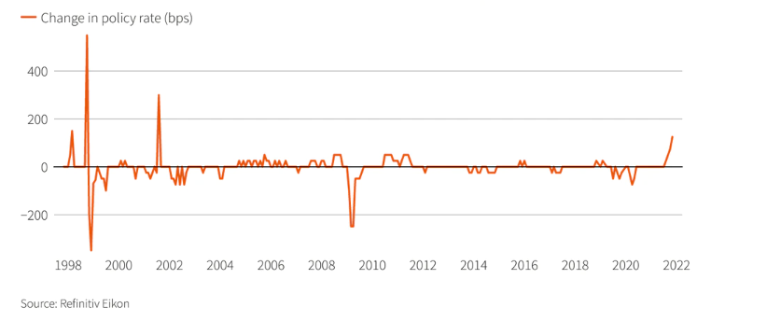

Slide 19
Economic Factor: GDPs
Chilean economy is growing strongly in terms of GDP (Gross Domestic Product)

Slide 20
Economic Factors: Tariffs
The trade between US and Chile is zero tariffs, but products not from US or FTA (Free Trade Areas) countries, Chile use 6% tariffs
Chile tariff rates for 2019 was 0.43%, a 0.06% decline from 2018.
Chile tariff rates for 2018 was 0.49%, a 0% increase from 2017.

Slide 21
Economic Factors: Cell Service providers
Prepaid SIM
Moviestar
Entel
Claro
WOM

Slide 22
Political and Legal Factors
Parker Hoyt

Slide 23
Political Factor: Government
Chile is run as a Representative Democratic Public
Officials and representatives are elected by the people
The Chilean President is both Head of State and Government
Chilean political atmosphere is relatively unstable
Has caused some social dispute
Chileans have sentiment towards government
Can create uncertainty for business
Notes:
Parker

Slide 24
Political Factor: Mutual Political Relationship
Chile and Finland have had diplomatic relations since before World War II
Even though there was political strain due to the war, the two were able to uphold their political relations
Chile is Finland’s second largest trading partner in Latin America
Chile and Finland have a strong trade relationship
Notes:
Parker

Slide 25
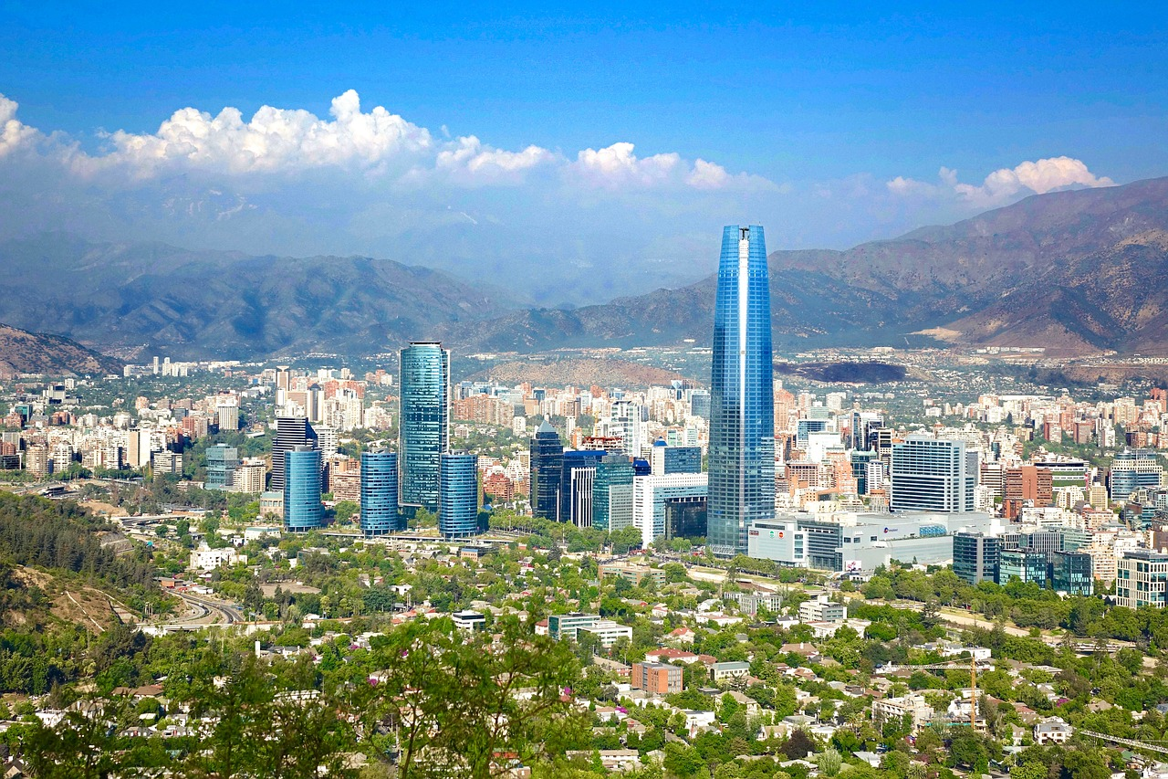
Political Factor: Foreign Investment
Chile is the strongest location for foriegn investment in South America
Richness of natural resources
Stable macroeconomic system
Major growth potential
Judicial security
Low level of risk
High quality of infrastructure

Slide 26
Labor Laws
Legal Working Age
Legal Workweek
Legal Work Day
Minimum Wage
Maternity Leave
Minimum of 15 years old
Maximum of 6 days or 45 hours
Maximum of 10 hours
Roughly $408 (USD) per month
30 weeks
(6 before and 24 after birth)
Notes:
Parker
https://iclg.com/practice-areas/employment-and-labour-laws-and-regulations/chile

Slide 27
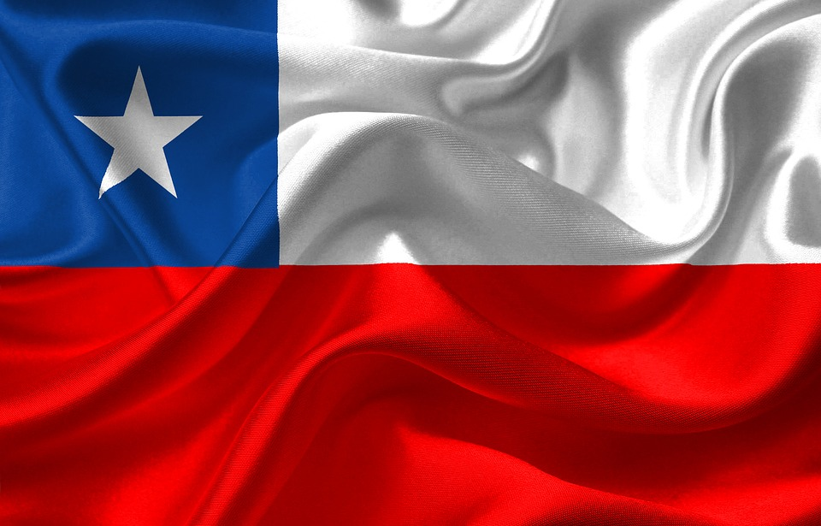
Relations with the EU
Association Agreement
Established in 2002
Included Free Trade Association (FTA) in 2003
FTA covers EU-Chile relations
Notes:
Parker

Slide 28
Relations with the EU
EU-Chile Relationship
The EU is Chile’s third largest trading partner
The EU is Chile’s third largest supplier and Chile’s third largest export market (after China and US)
Notes:
Parker

Slide 29
Relations with the EU
Current EU-Chile FTA
Removes tariffs
Removes trade barriers
Guarantees European intellectual property rights in Chile
Notes:
Parker

Slide 30
Socio-Cultural Factors
Chaemin Lim

Slide 31
Socio-Cultural Factor: Social Norms
Chileans are friendly and hospitable
During conversations or greeting one another, a hug and a kiss on the cheek (true among close friends and relatives)
People tend to stand closer than you could imagine, and have more direct eye contact
In most informal situations, it is not considered to be rude to late
Basics of Chilean etiquette
Greet everyone in a group individually
Chileans typically don’t eat dinner until 8pm or later
Don’t give yellow, purple, or black flowers as a gift (disrespect, death)
Notes:
https://www.hofstede-insights.com/country-comparison/finland/

Slide 32
Socio-Cultural Factor: Social Norms
Do:
Make direct eye contact with people
Keep your hands above the table while eating
Address men as Senor, and women as Senora
Don’t:
Use a lot of hand gestures in conversation (Many hand gestures might be misinterpreted as being rude)
Address someone by their first name until invited to do so
Openly discuss politics, unless with close friends
Notes:
https://www.hofstede-insights.com/country-comparison/finland/

Slide 33
Socio-Cultural Factor: History/Religion
Spanish is the official language
The majority of Chileans are Roman Catholic (55-60%) and around 15% are Christian
About 25% of Chileans think religion is not important in their lives
The country remained Spanish control under the Viceroyalty of Peru until Napoleon conquered Spain in 1807 and Chile consequently declared independence in 1810
Notes:
https://www.hofstede-insights.com/country-comparison/finland/

Slide 34
Socio-Cultural Factor: Consumer Behavior
Chile’s population is ageing but remain relatively young
The median age is about 35.5 years
The country’s growth has enabled consumers to have better quality products
Notes:
https://www.hofstede-insights.com/country-comparison/finland/

Slide 35
Socio-Cultural Factor: Hofstede’s Dimensions of Culture
Individualism or Collectivism
Large Power Distance or Small Power Distance
Strong Uncertainty Avoidance or Weak Uncertainty Avoidance
Masculinity or Femininity
Long Term Orientation or Short Term Orientation
Indulgence or Restraints
Chile
Finland
Notes:
https://www.hofstede-insights.com/country-comparison/finland/

Slide 36
Socio-Cultural Factor:
Phone Alternatives
Phone Booths
Call Centers
Phone Cards
Cheaper
Common
Cheaper
More Comfortable
Pre-Paid
Domestic and International

Slide 37
Competitive Environment
Hannah Benedict

Slide 38
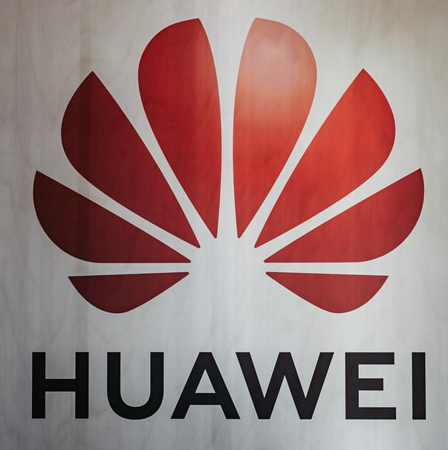
Major Competitors
Chilean Portable Consumer Electronics Market: 10 Million Units in 2021 (and growing)
International Competitors (Brand Share of Market):
Samsung 43.6%
Huawei 18.7%
Lenovo 9.9%

Slide 39
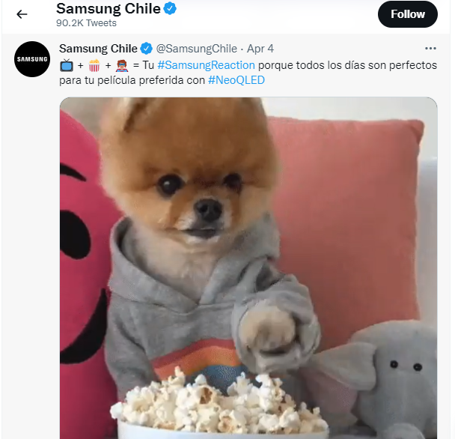
Major Competitors (cont.)
Samsung
Cutting-edge technology
Higher priced phones ($1800)
Market through brand outreach (twitter)

Slide 40
Major Competitors (cont.)
Huawei
Produces basic cell phones, emphasizes flashier smartphones
Lenovo (Motorola)
Smartphones at high and low price points
Nokia’s diversification of offerings and target market set it apart from other cell phone manufacturers that currently take a majority market share in Chile

Slide 41
Physical Factors
Jacob Lau

Slide 42
Physical Factor: Geographical Features
Mountains
Glaciers
Fault Lines
Volcanoes
...
...
Major barrier production
Limits mobility of goods
Over 80% of South America’s Glaciers lie in Chile.
...
...
Over 2000 Volcanoes, though only 36 are currently active as the rest are dormant
Creates uncertainty
Impacts architecture

Slide 43
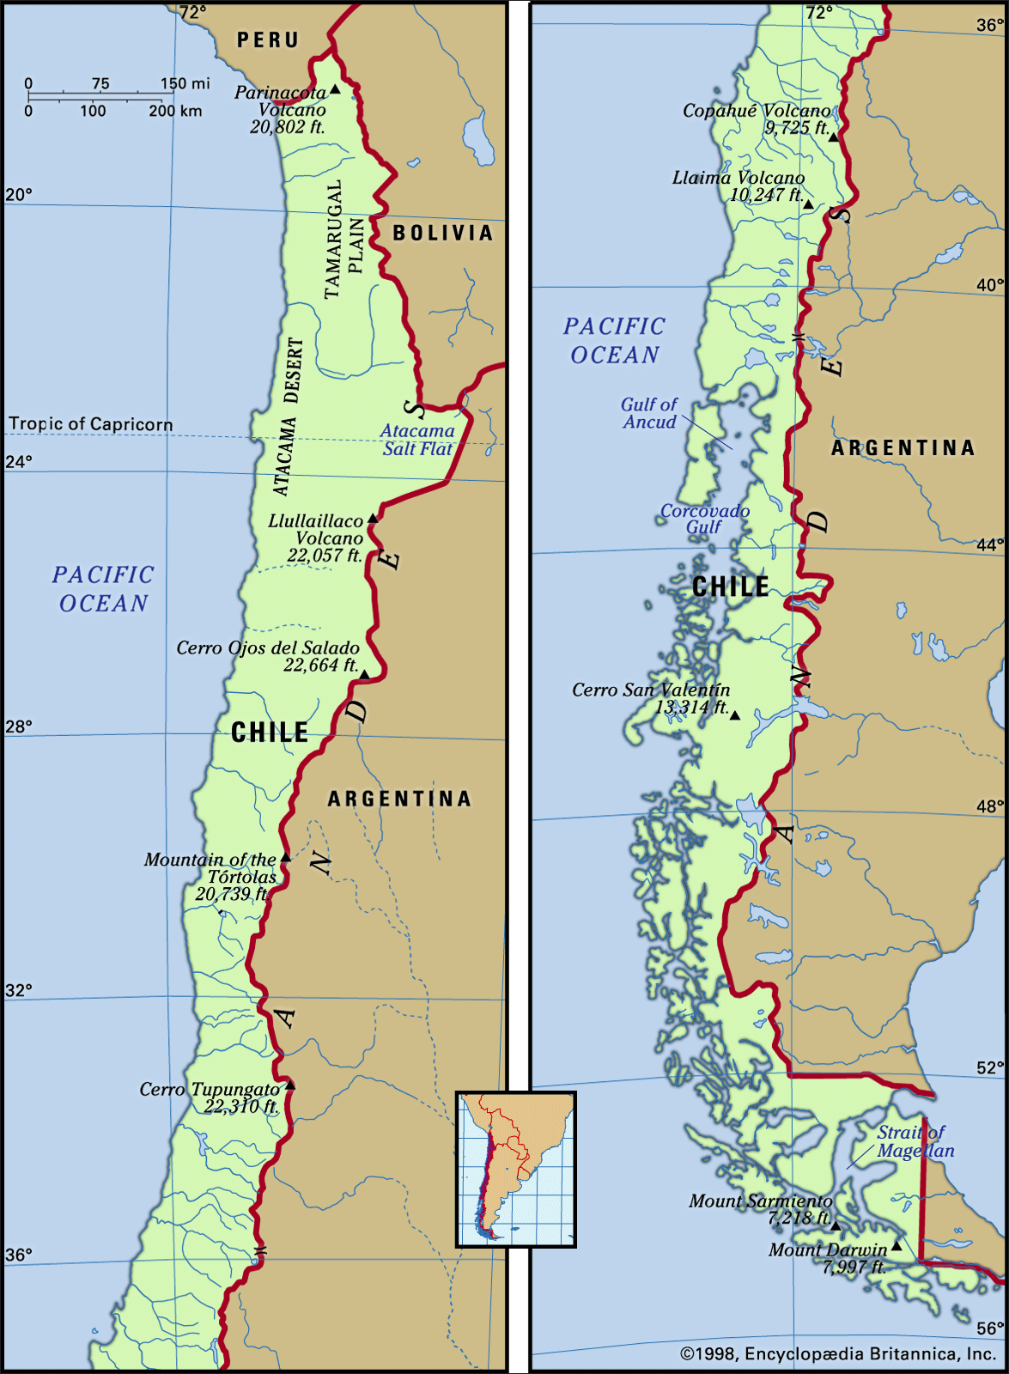
Physical Factors: The Country
Three Parallel North-South Units
Andes Mountains:
Coastal Ranges:
Intermediate Depression:
Extends almost the length of the country
Forms most of border with Argentina, separating the 2
Can reach as high as 19,500 feet
Natural ridges between coast and Intermediate Depression
Intensive Agriculture has left soil mostly eroded
Central Valley; Most populated area in Chile, sediments from mountains give way to mineral-rich soil
Northern; Plateau
South; Forests and descent into Sea level
Flanked with multitude of Fault Lines

Slide 44
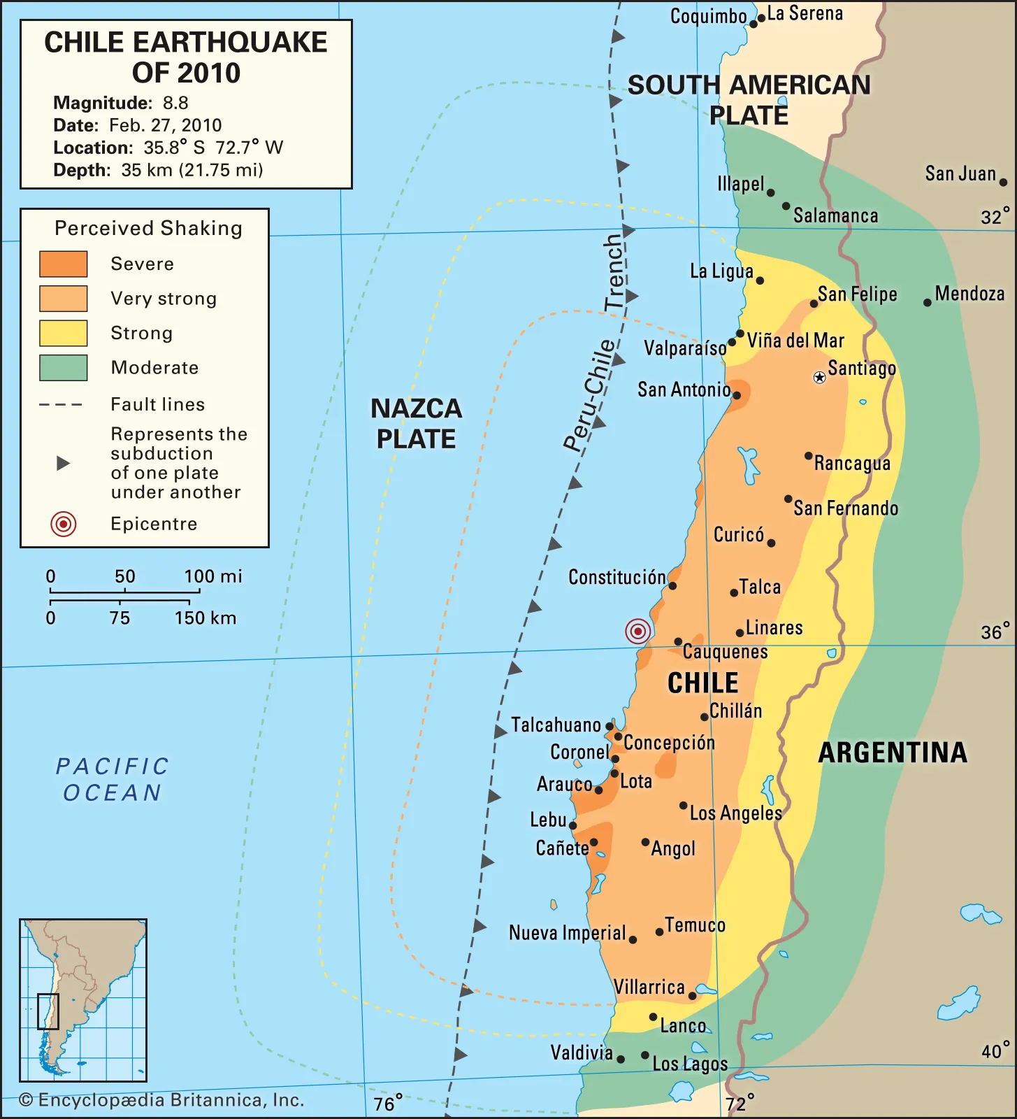
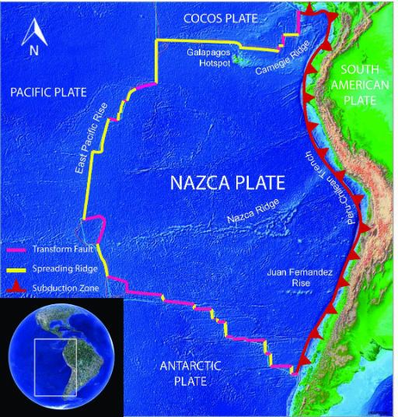
Physical Factors: Earthquakes
Average of 7.5-7.6 Earthquakes per Decade
Lies next to Subduction Zone of Nazca Plate
Multitude of Fault Lines, such as Atacama Fault Zone
Earthquake-specific Architecture a must

Slide 45
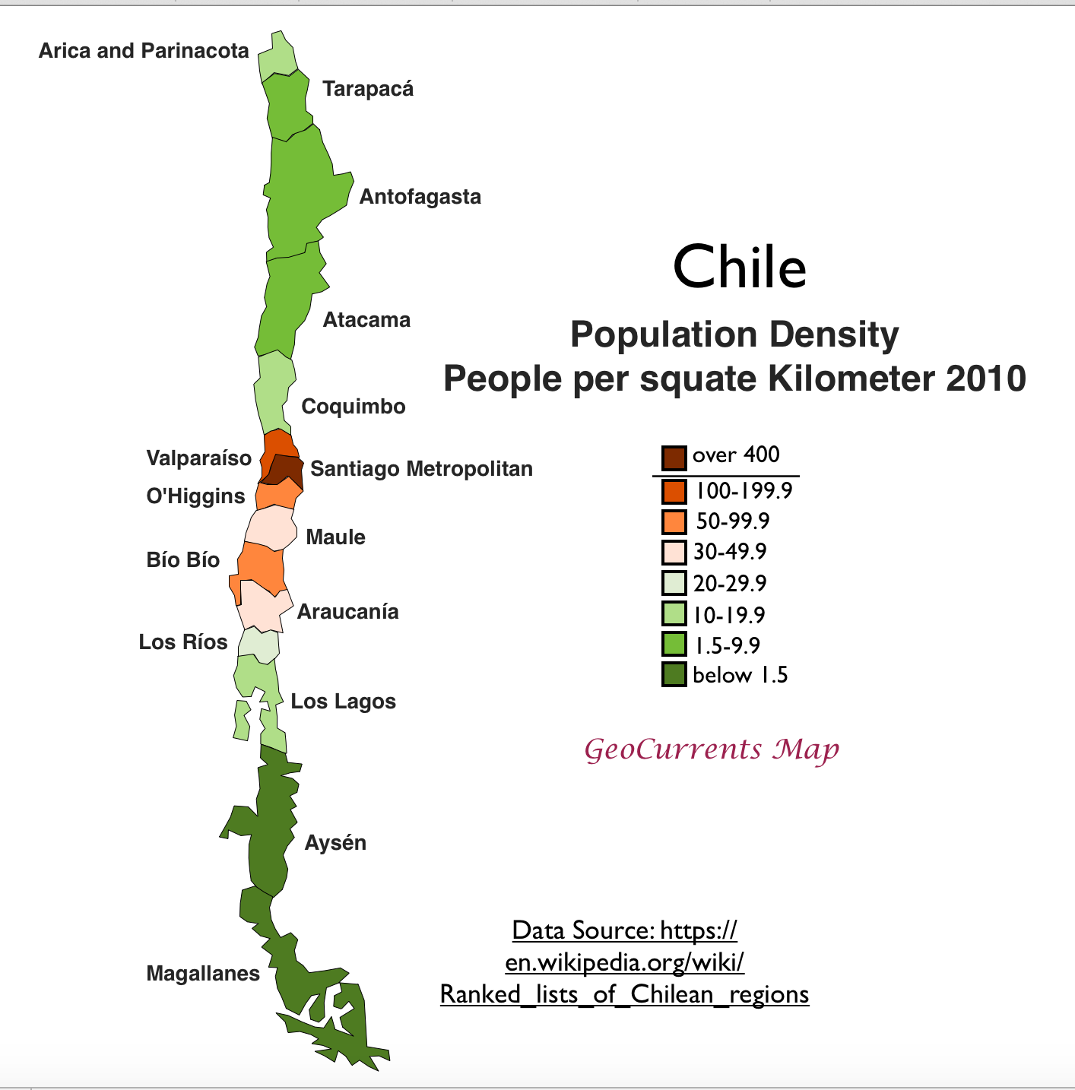
Physical Factors: Population Density
More than 19 Million people in Population
Average of 66 people per square mile
Central Valley remains most populated region

Slide 46
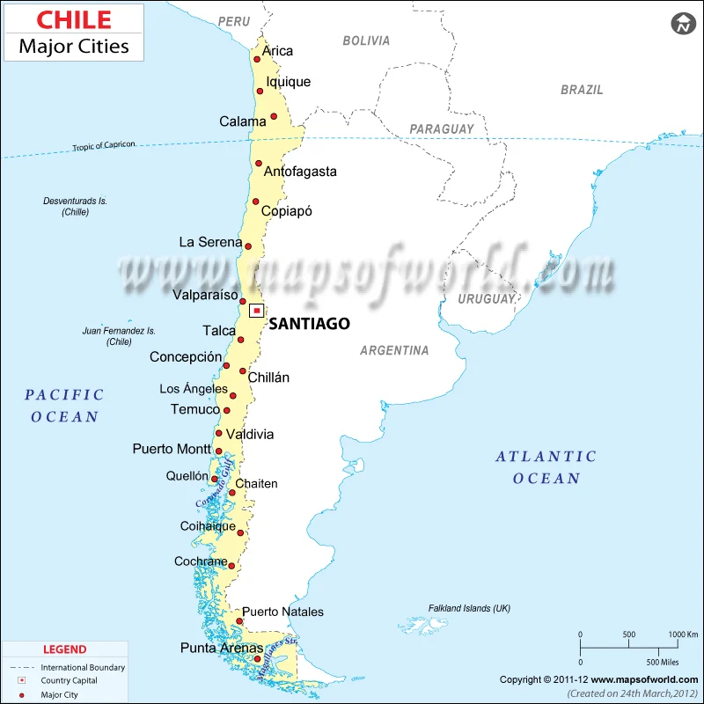
Major Cities

Slide 47
Physical Factors: Transportation
Railroads
Aerial Transport
Estimated 3,079 million tons-km transported in 2019
“Chile on Rails”
$5b investment project into railroad system started in 2020
Estimated 1,458 million tons-km delivered via aerial transport in 2020

Slide 48
Physical Factors: Distribution
Agent/Distributor
Office Establishment
Direct Marketing
Express Delivery
...
...
...
...
Multiple firms in a relatively smaller market
Traditional means or self service online
Several reliable US services in Chile already (FedEx, UPS, etc)
Catalog sales/direct stores

Slide 49
TRIVIA
For Smartphones, what method of pricing does Nokia use?
Skimming

Slide 50
TRIVIA
What form of government does Chile use?
Representative Democratic Republic

Slide 51
TRIVIA
What form of currency does Chile use?
Chilean Peso

Slide 52
TRIVIA
When was the FTA established between the EU and Chile?
2003

Slide 53
TRIVIA
What is the mountain range in Chile?
Andes Mountains

Slide 54
TRIVIA
What is the median age of the Chilean population?
35.5 years old

Slide 55
TRIVIA
What is the population density of Chile?
Roughly 66 people per square mile

Slide 56
That’s All Folks!
Thank you all for attending

